Slide 1
DESIGN & ANALYSIS OF ALGORITHM
PCC-CS404

Slide 2
Asymptotic notation Analysis of algorithm
Asymptotic analysis refers to computing the running time of any operation in mathematical units of computation. Example: T_{A}(N)=O(n^2)
Types
Big oh or upper bound
Big theta or tight bound
Big omega or lower bound

Slide 3
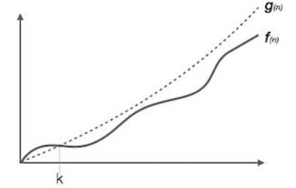
Big oh or upper bound
The function f(n)=O(g(n)) iff ∃ positive constant c and n₀ such that f(n)<=cg(n) for ∀ n> n₀ .
_{growth}
n₀ input

Slide 4
Big oh or upper bound
The function f(n)=O(g(n)) iff ∃ positive constant c and n₀ such that f(n)<=cg(n) for ∀ n> n₀ .
Example- f(n)=6n+7
_{6n+7 <= 6n+7n}
c=13 g(n)=n so complexity= O(n) , n₀ ₌₁

Slide 5
Big oh or upper bound
The function f(n)=O(g(n)) iff ∃ positive constant c and n₀ such that f(n)<=cg(n) for ∀ n> n₀ .
Example- f(n)=6n+7
_{6n+7 <= 6n}²_{+7n}²
_{c=13 g(n)=n}² _{so complexity= O(n}²_{) ,} n₀ ₌₁

Slide 6
Big oh or upper bound
The function f(n)=O(g(n)) iff ∃ positive constant c and n₀ such that f(n)<=cg(n) for ∀ n> n₀ .
Example- f(n)=6n+7
_{so complexity= O(n}²_{) or O(n) ,} n₀ ₌₁
1 < logn < √n < n < nlogn <n² <n³< ………………..<2^{n}<3^{n}< n^{n}
_{N.B- choose Closest one}

Slide 7
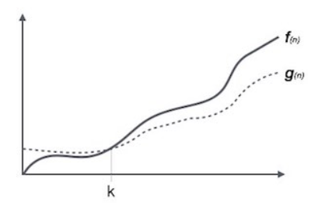
Big omega or lower bound
The function f(n)= (g(n)) iff ∃ positive constant c and n₀ such that f(n)>=cg(n) for ∀ n>n_{0.}

Slide 8
Big omega or lower bound
The function f(n)= _{Ω}(g(n)) iff ∃ positive constant c and n₀ such that f(n)>=cg(n) for ∀ n>n₀ .
Example- f(n)=6n+7
_{6n+7 >= n , n0=0}
c=1 g(n)=n so complexity= Ω(n) , n₀ ₌₀

Slide 9
Big omega or lower bound
The function f(n)= _{Ω}(g(n)) iff ∃ positive constant c and n₀ such that f(n)>=cg(n) for ∀ n>n₀ .
Example- f(n)=6n+7
_{6n+7 >= logn}
c=1 g(n)=logn so complexity= Ω(logn) , n₀ ₌₁

Slide 10
Big omega or lower bound
The function f(n)= (g(n)) iff ∃ positive constant c and n₀ such that f(n)>=cg(n) for ∀ n>n₀ .
Example- f(n)=6n+7
so complexity= O(logn) or O(n) , n₀ ₌₁
1 < logn < √n < n < nlogn <n² <n³< ………………..<2^{n}<3^{n}< n^{n}
_{N.B- choose Closest one}

Slide 11
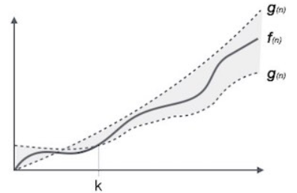
Big theta or tight bound
The function f(n)=O(g(n)) iff ∃ positive constant c1,c2 and n₀ such that
c2g(n) =< f(n)<=c1g(n) for ∀ n>n_{0.}
n₀

Slide 12
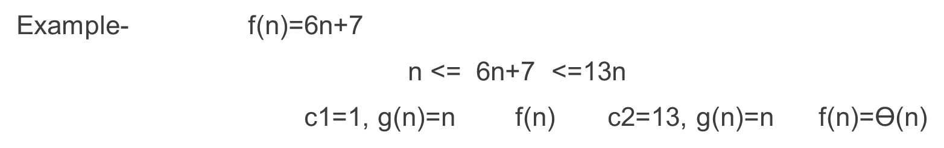
Big theta or tight bound
The function f(n)=O(g(n)) iff ∃ positive constant c1,c2 and n₀ such that
c2g(n) =< f(n)<=c1g(n) for ∀ n>n_{0.}

Slide 13
Big theta or tight bound
The function f(n)=O(g(n)) iff ∃ positive constant c1,c2 and n₀ such that
c2g(n) =< f(n)<=c1g(n) for ∀ n>n_{0.}
1 < logn < √n < n < nlogn <n² <n³< ………………..<2^{n}<3^{n}< n^{n}

Slide 14
Next class
Asymptotic Notation

